Slide 1
Data Storytelling
Group 5
Global You tube Statistics
Joseph Waihura
Liberty Glen
Pauline Gitau
Tyler Mercy

Slide 2
Business Problem/Question
What type of channel are our viewers most likely to engage with?
How can we better monetize our videos?
How can we better target our videos to the right audience?
What content can we provide to retain viewers as subscribers?
Does the population of a country affect the sum of video views?

Slide 3
Data Source and Details
With comprehensive details on top creators' subscriber counts, video views, upload frequency, country of origin, earnings, and more, this treasure trove of information is a must-explore for aspiring content creators, data enthusiasts, and anyone intrigued by the ever-evolving online content landscape. Immerse yourself in the world of YouTube success and unlock a wealth of knowledge with this extraordinary dataset

Slide 4
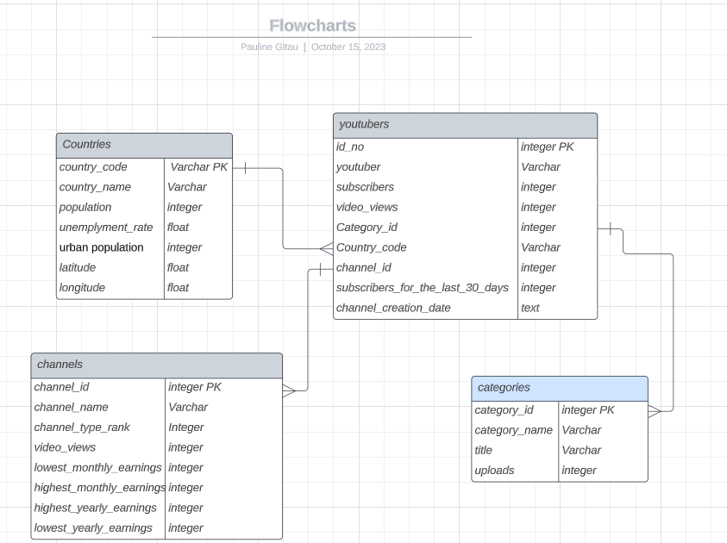
SQL database design

Slide 5
Insights
Our you tube dataset shows that majority of viewers are from India indicating the potential increased viewership in this country, with a preference to the music channel type.
By analyzing our you tube data, the most effective channel types have the most subscribers. This leads to increased yearly earnings depending on the location of the you tuber.
Our dashboard reveals that we can look at a country and the sum of video views. This will reveal further the sum of subscribers per channel type. With this we can determine which channel type to target to which countries.
From the dashboard, we can look at the you tuber with the highest subscribers in the last 30 days. Thereafter determine the you tuber’s channel type considering the location and encourage you tubers to upload videos in the same channel type.
According to our dashboard, the population of a country affects the number of video views.

Slide 6
Next Steps…
Are the uploads made yearly or monthly?
We should check the unemployment rate per population and encourage people in places with high unemployment rate to create content within the channel types that are highly viewed in their country. This will also lead to increase in earnings for both you tube and the unemployed.
Does the urban population affect the unemployment rate? Do the countries with the high urban population have high unemployment rate? Do the countries with high unemployment rate have high video views?

